Slide 1
eXo Fundamentals Training
Portal Elements and Organization Model
Notes:
1

Slide 2
Discovery
2
Notes:
2

Slide 3
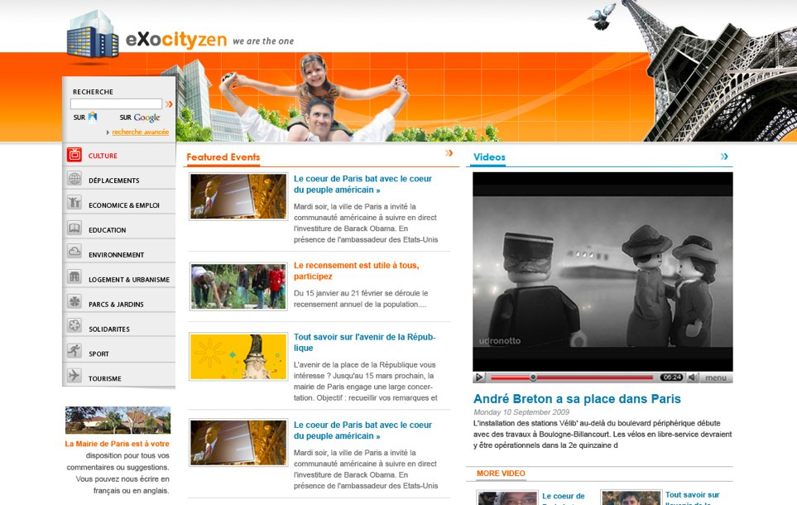
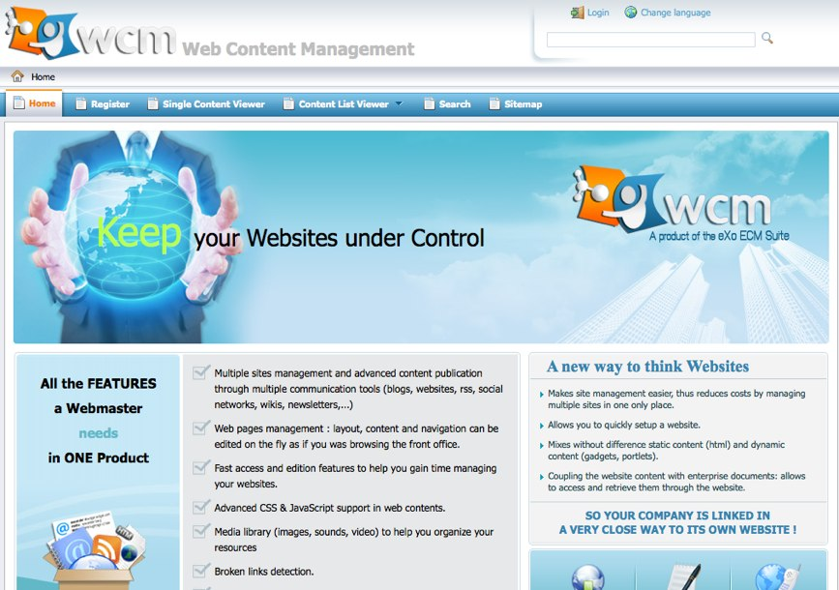
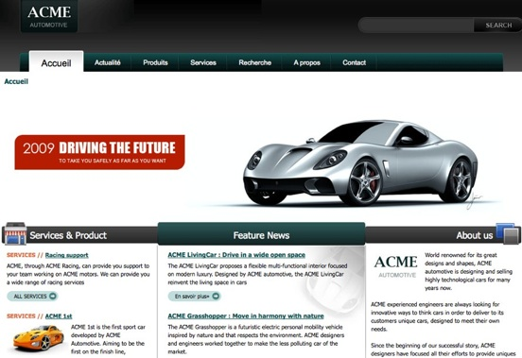
Image Discovery
Notes:
3

Slide 4
Why a portal ?
Improvement of productivity
Single Entry Point
Single Sign-On
Application Integration
Ressources leverage
Centralized User Management
Simplified Administration and Deployment

Slide 5
Why eXo Portal ?
Standard Respect
Professional Open Source
Integrated Applicative Suite
eXo innovates (ex: WebOS)
Flexible Roadmap

Slide 6

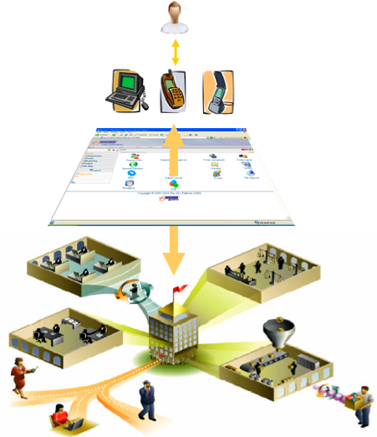
Enterprise Portal
Collaborative
Applications
Workflows
Intranet
Documents

Slide 7
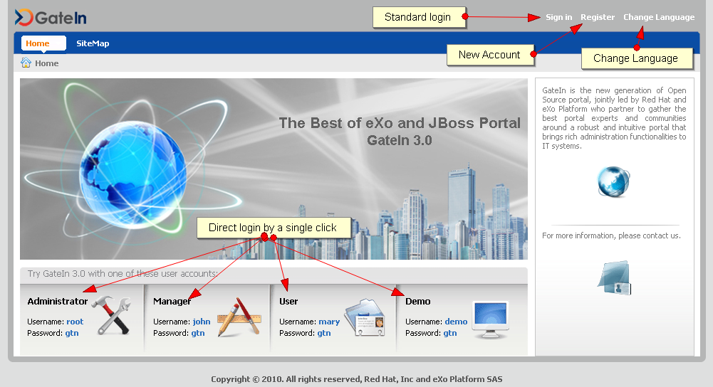
Homepage
Notes:
7

Slide 8
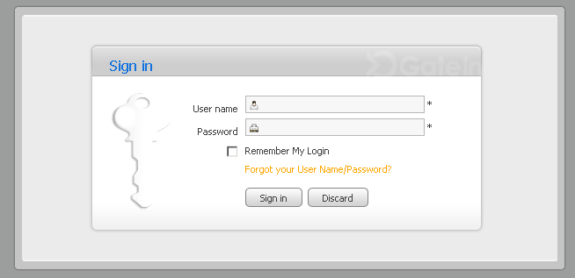
Log in
Notes:
8

Slide 9
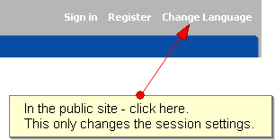
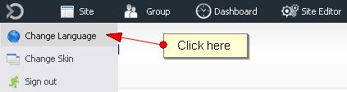
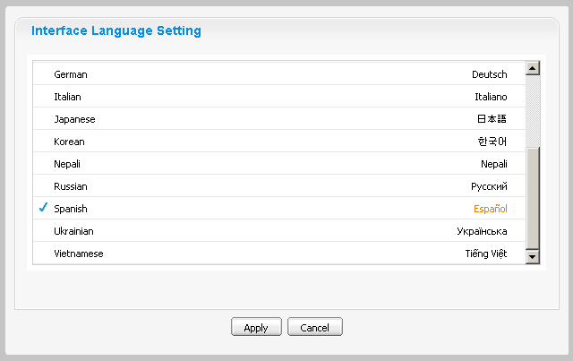
Language Setting
GateIn is available in 16 languages
The choice is stored in the user preferences.
If the is “anonymous” – public site – then the language choice is stored in the session.
Notes:
9

Slide 10
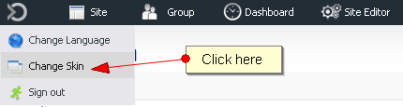
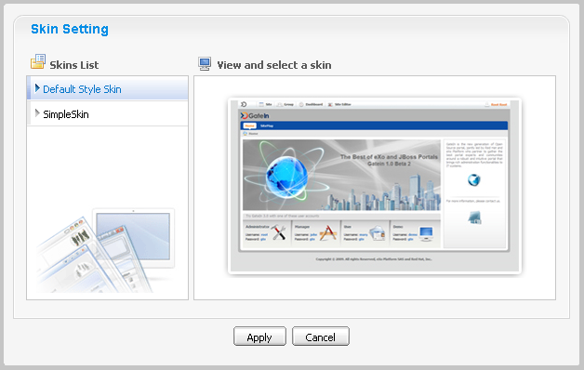
Skin Setting
Extensible List
Notes:
10

Slide 11
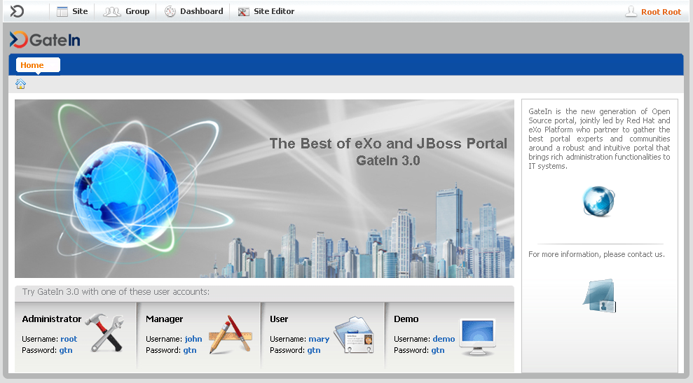
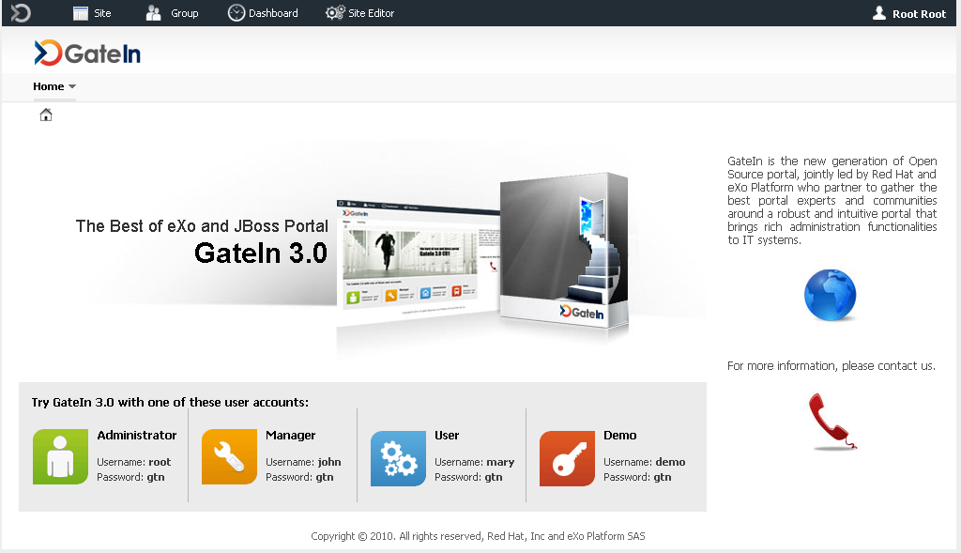
Switch between Skins
Switch in 2 seconds
Notes:
11

Slide 12
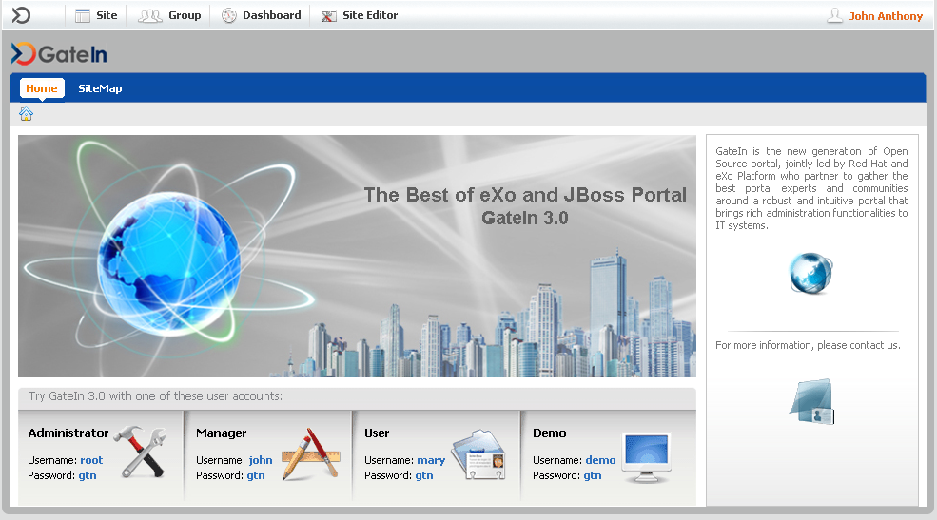
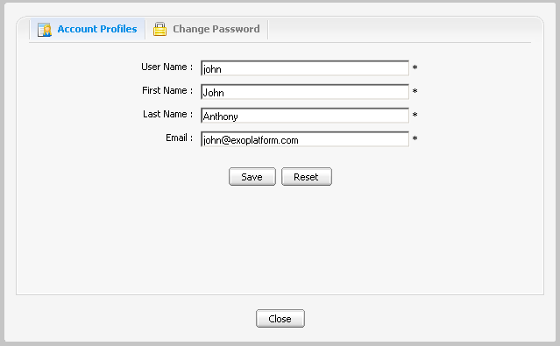
User Account
Click on name
Notes:
12

Slide 13
Admin Tool Bar
13
Notes:
13

Slide 14
Admin Tool Bar
The Admin Tool Bar contains menu entries for:
Sites
Groups of the current user
Current User (Dashboard)
Site/Group/Dashboard Editor, depending on the current page.
Notes:
14

Slide 15
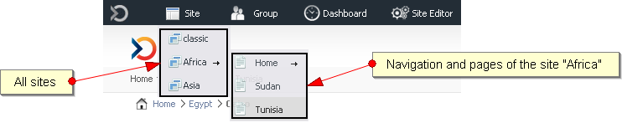
Admin Tool Bar - Sites
Select your site
Notes:
15

Slide 16
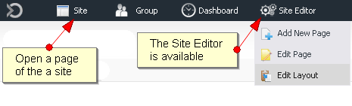
Admin Tool Bar - Sites
Open a page of a site
The Site Editor menu appears at the right
Notes:
16

Slide 17
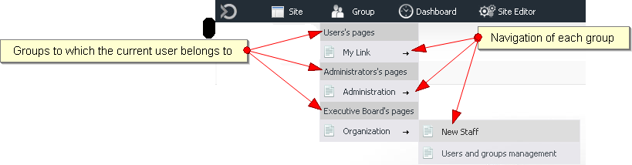
Admin Tool Bar - Group Navigations
Each user sees only the navigations of her or his group
Notes:
17

Slide 18
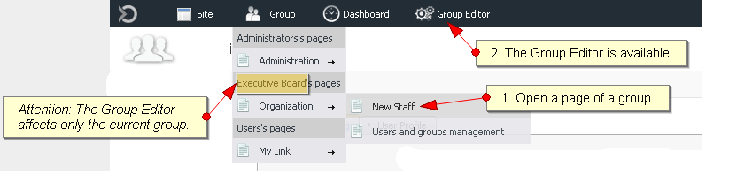
Admin Tool Bar - Groups
Group Editor for the groups of the current user
Notes:
18

Slide 19
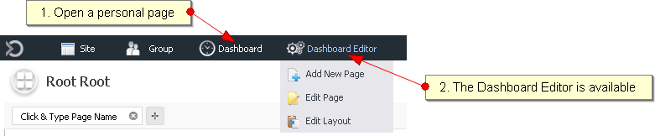
Admin Tool Bar - Dashboard
Current User (Dashboard)
Notes:
19

Slide 20
Admin Tool Bar – Three Editors
Sites
Groups of the current user
Current User (Dashboard)
Notes:
20

Slide 21
Personal Dashboard and Gadgets
21
Notes:
21

Slide 22
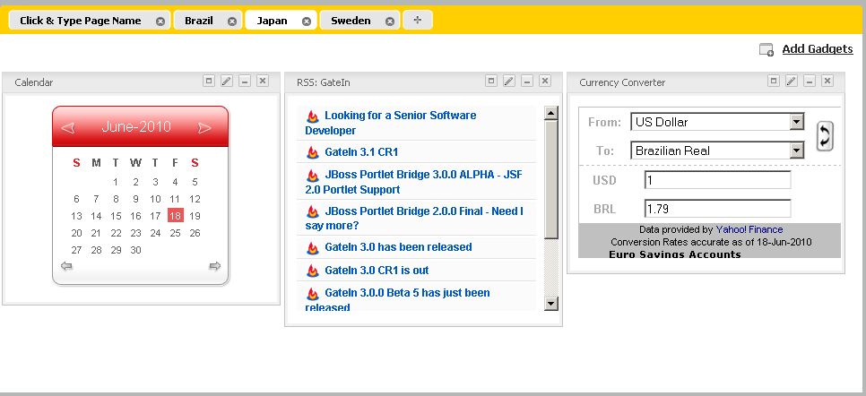
Gadgets
Embeddable chunk of Javascript
Live user interface
Accessible from the Dashboard, WebOS or using a Gadget Wrapper
Many implementations : Google Gadget standard in GateIn
Notes:
22

Slide 23
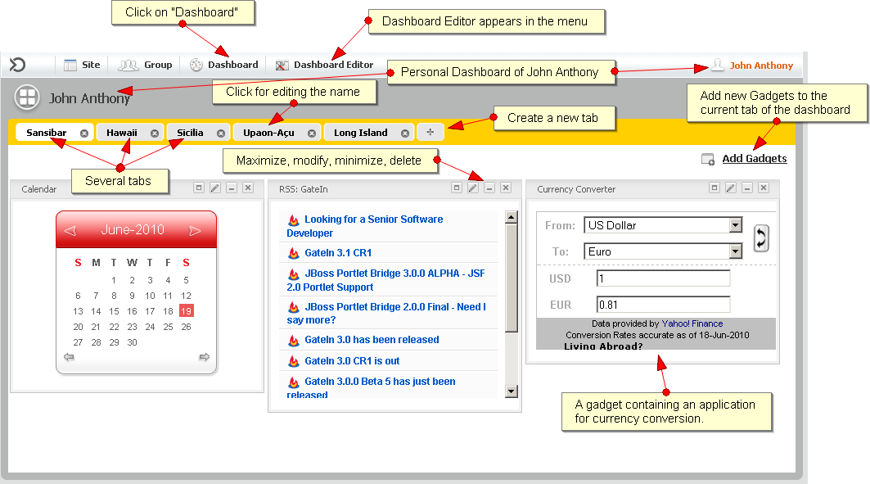
Personal Dashboard
Notes:
23

Slide 24
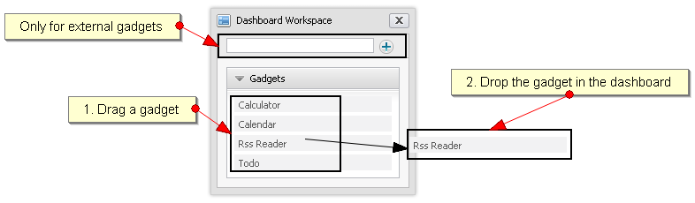
Internal Gadget
Internal gadgets are stored on the eXo server
You can drag it directly to the dashboard
Notes:
24

Slide 25
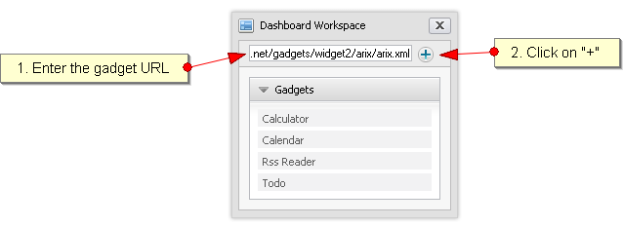
External Gadget
External gadgets are stored on other servers
You need to enter or copy a complete URL
Notes:
25

Slide 26
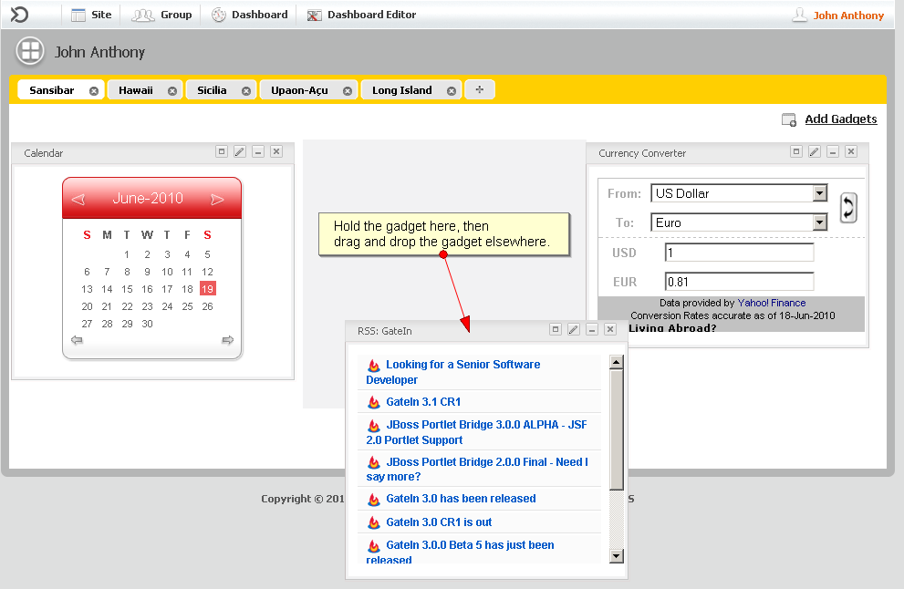
Drag your Gadget
Notes:
26

Slide 27
Exercise 0: Start and Play
Requirement:
Java SDK 6 (For eXo Portal it was Java 5)
Notes:
27

Slide 28
Exercise 0: Start and Play
Start the portal
Create a directory $TRAINING_HOME and unzip GateIn-x.y.z-FINAL-tomcat.zip
Search for the binary subfolder:
.../GateIn-x.y.z-FINAL-tomcat/bin
In command line, launch:
Linux / Mac OS : ./eXo.sh start or gatein.sh start
Windows : exo start or gatein start
Wait
Watch the startup messages.
The startup is finished when you see “INFO: Server startup in 71219 ms”.
Start a browser at: http://localhost:8080/portal/
Notes:
28

Slide 29
Exercise 0: Start and Play
Stop the portal
To stop the server , simply type Ctrl+C from the console
You can also use : ./eXo.sh stop or gatein.sh stop
To re-init and get the default configuration, delete :
../GateIn-x.y.z-FINAL-tomcat/gatein/data
../GateIn-x.y.z-FINAL-tomcat/work
Notes:
29

Slide 30
Exercise 0: Start and Play
Settings
Before logging in, change the language
Log in as mary
Change the language for mary
Change the skin for mary
Change her email address
Admin Tool Bar
Click on the different menu points and observe how the Admin Tool Bar changes
Notes:
30

Slide 31
Exercise 0: Start and Play
Dashboard
Log in as mary
Create two dashboards with different names
Log in as john
Verify that his dashboard is empty
Create a dashboard for john
Add an external gadget to the dashboard: http://shazingo.com/lig/lg/142002.xml
Notes:
31

Slide 32
Organisation Model
32
Notes:
32

Slide 33
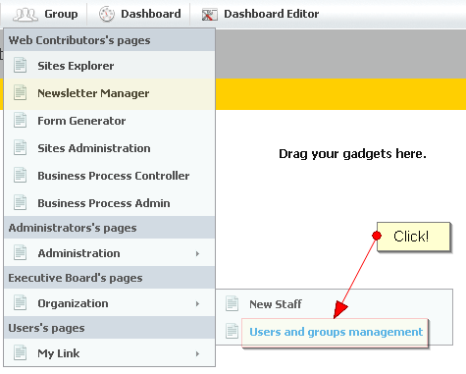
Organisational Model
Components
Users
Groups
Memberships
Authentication and Authorization
Generalized model for the platform
Database storage (Hibernate) or Directory storage (LDAP)
Notes:
33

Slide 34
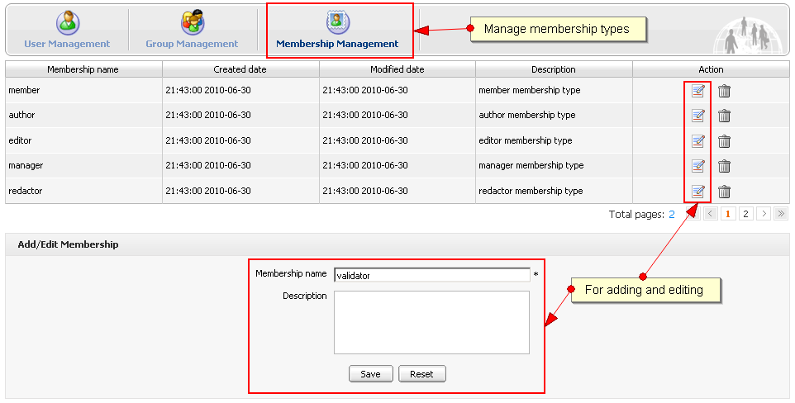
Organisational Model - Memberships
Membership types are similar to roles: manager, validator, editor.
Membership types are shared among all groups.
When a user is added to a group she or he must be assigned with membership type to that group.
The asterisk “*” stands for “all membership types”.
Membership versus “membership type: When a user is assigned to a group with a membership type you say that the user has a “membership”.
Notes:
34

Slide 35
Organisational Model - Memberships
Notes:
35

Slide 36
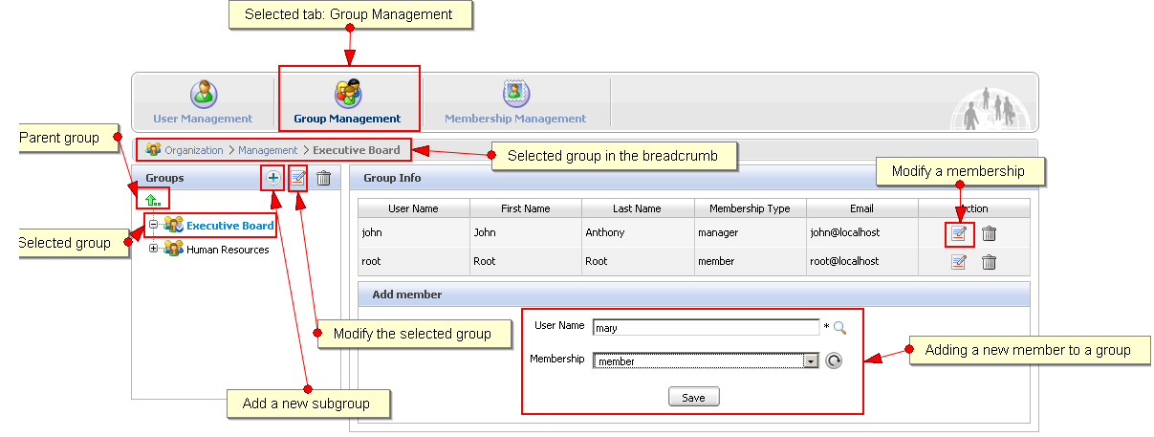
Organisational Model - Groups
Groups are organized in an hierarchy, but there is no inheritance.
A user can be several times in the same group having different memberships.
A user can be in one or several groups
Notes:
36

Slide 37
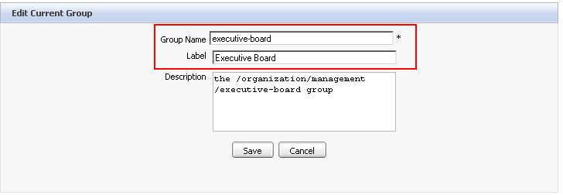
Organisational Model - Groups
Groups have a name. The name is used internally and cannot be modified.
The group label is used for the interfaces and can be modified at will.
Notes:
37

Slide 38
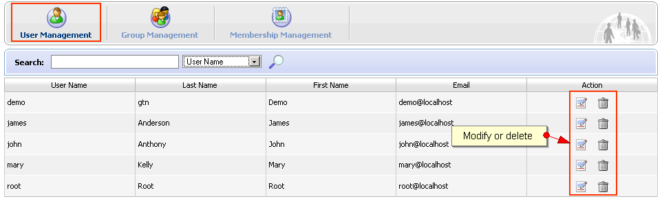
Organisational Model - User
User Management
Notes:
38

Slide 39
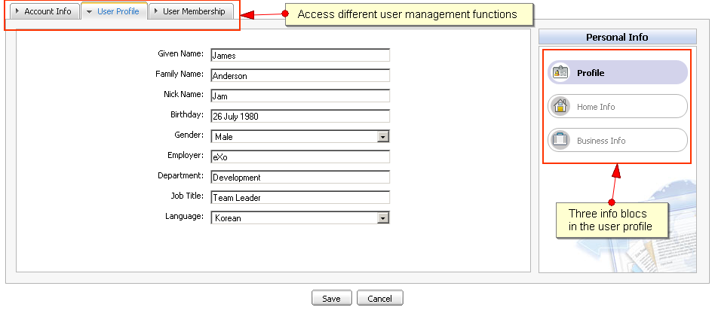
Organisational Model - User
Modify user information, delete memberships
Notes:
39

Slide 40
Exercise 1: Memberships
Create a new member
Open the application “’New Staff” (Group/Organisation/New Staff)
Create a user “Elena”.
Manage users and groups
Open the application “Users and group management” (in Group/Organisation)
Search for the user “Elena”. Is she already member of a group?
Create a new membership type “translator”.
Create a new subgroup in platform called “training”.
Add Elena to the new group with the new membership type.
Add Elena a second time to that group user the “manager” membership type.
Notes:
40

Slide 41
Portal
41
Notes:
41

Slide 42
Portal
One portal per site, per group, per user.
Components
Set of pages
Set of navigations
Common layout
Effect: Different layout and different navigations for site pages, group pages and user pages.
Notes:
42

Slide 43
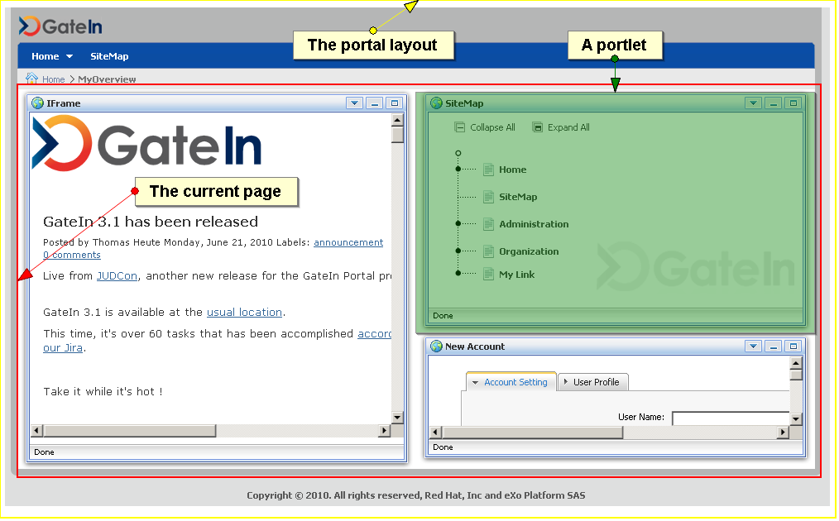
Portal
Portal : manages the aggregation and personalization of the portlets.
Many portals can run on the same eXo Platform server. Each of them has a different URL.
Each portal contains a number of pages.
Each page contains one or several portlets.
Notes:
43

Slide 44
Portal
Notes:
44

Slide 45
Portal
Portlet arrangement
Portlet4
Portlet1
Portlet2
Portlet3
Notes:
45

Slide 46
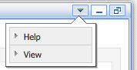
Portlets
Portlet : A rectangular bloc which allows to access to a content or a service.
Each portlet has some preferences, settings and decorations.
The portlet can be positioned in any place of a page.
You can reuse the same portlet several times: Then we say there are several instances of the same portlet.
Each instance of the same portlet can be configured differently.
Window decoration (optional)
Window states: maximized, minimized
Portlet Modes: view, edit, help
The combination of a portlet instance + preferences + decorations is also called an “application”.
Notes:
46

Slide 47
Page
Contains a set of applications.
Defines the layout of these applications.
There a many pages on a portal.
Permission Settings
Access permission
Edit permission
3 page types : portal, group and user
Notes:
47

Slide 48
Layout
48
Notes:
48

Slide 49
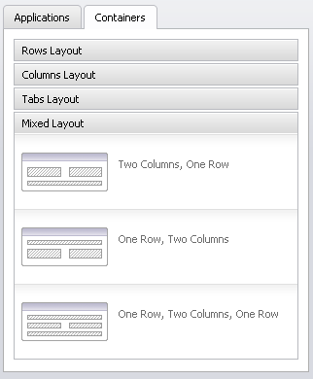
Containers
Containers help to position elements on the page.
They are invisible.
You can use them in :
Page layout
Portal layout
You can combine different containers.
Notes:
49

Slide 50
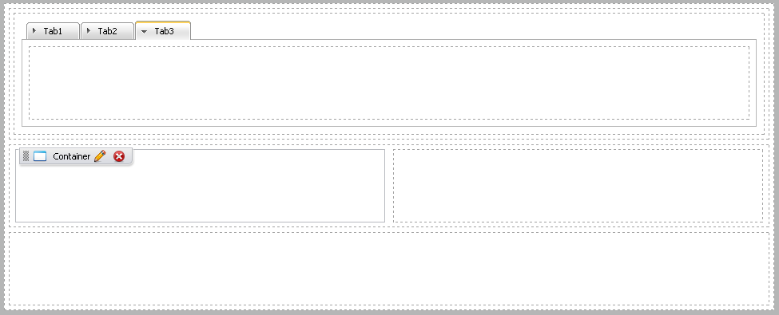
Containers
Container combination
Notes:
50

Slide 51
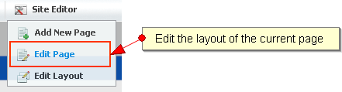
Page Layout
Defines the layout of the current page.
You see the position of the applications in the page and a page editor.
The page editor shows an applications and a containers tab. Clicking on these tabs switches also the between an application and a container mode.
Drag and drop an application from the page editor to the page: In that moment you create a new instance of the portlet.
Drag and drop applications inside a page.
Notes:
51

Slide 52
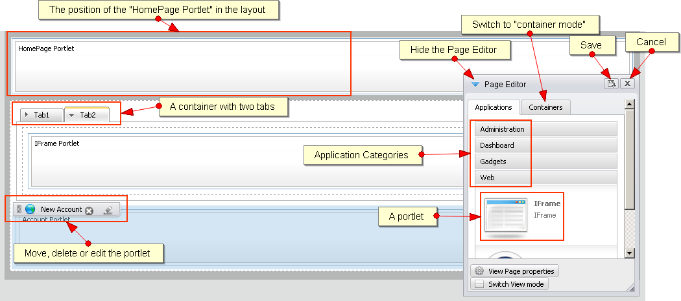
Page Layout
Notes:
52

Slide 53
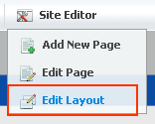
Portal Layout
Defines the layout of all pages of the portal.
Works the same way as the page layout.
A special place holder called “Portal Page” indicates the position of the pages in the portal.
Notes:
53

Slide 54
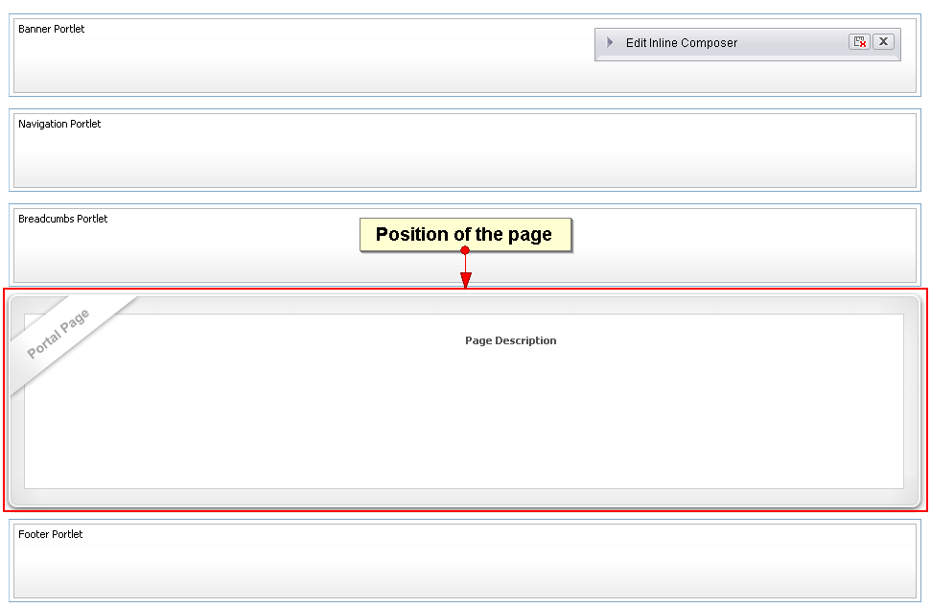
Portal Layout
Notes:
54

Slide 55
Exercise 2: Layout
Page Layout
Go to the home page of the classic site.
Click on Edit Page.
Drag some applications in the layout.
Drag a three tabbed container in the layout.
Place applications in the container. Save.
Portal Layout
Click on Edit Layout, modify the layout of the portal. Save.
Switch between the homepage and “site map” page in order to see the differences.
Notes:
55

Slide 56
Sites
56
Notes:
56

Slide 57
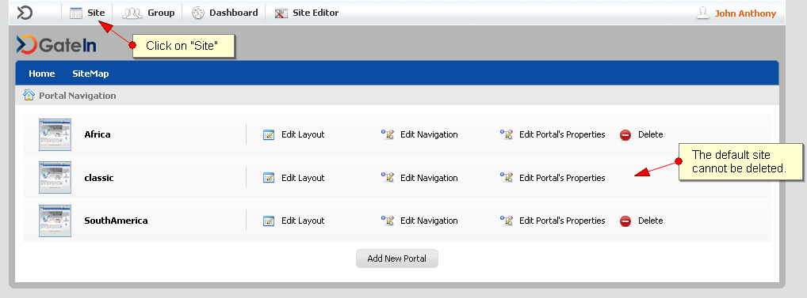
Manage your Sites
You can manage several sites.
Sometimes the terms “site” and “portal” are interchanged.
Each site has it’s own layout, navigation, pages and properties.
Notes:
57

Slide 58
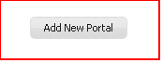
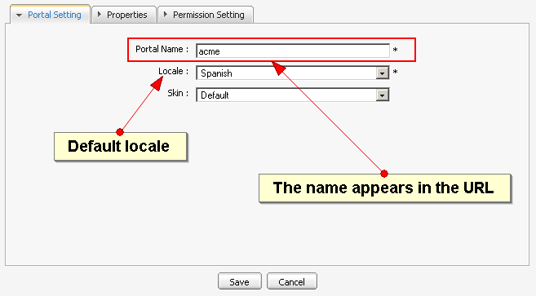
Manage your Sites
Click on “Add New Portal” and choose a name, locale and skin for your site.
Notes:
58

Slide 59
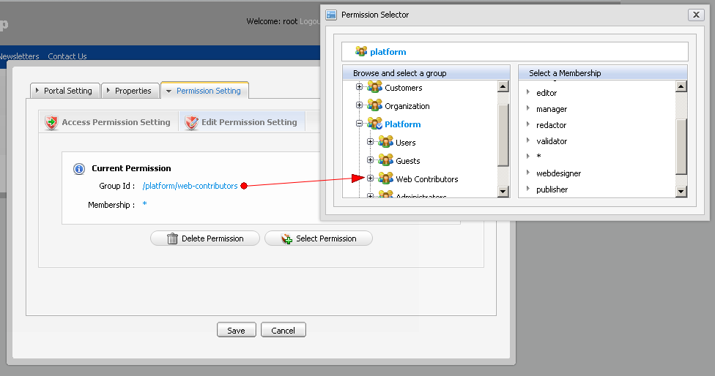
Site Permissions
Distinction of access and edit Permissions
Notes:
59

Slide 60
Exercise 4: Site
Create a new Site
Login as root.
Click on Site in the Admin Tool Bar and add a new site (portal) called “training”.
Allow access to everyone. Gives edit rights to the group “platform/training”.
Save.
Open the layout of the training site and modify it.
Notes:
60

Slide 61
Navigation
61
Notes:
61

Slide 62
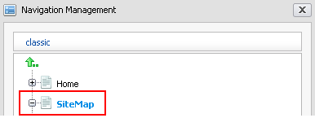
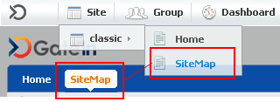
Navigation
Manage access to portal pages
Hierarchy structure of navigation nodes
Each node references a page
Aggregation types: portal, group, user
Navigation portlet: Represents the navigation in a menu
Notes:
62

Slide 63
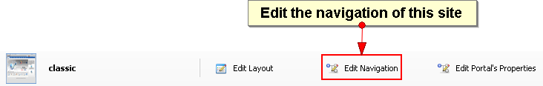
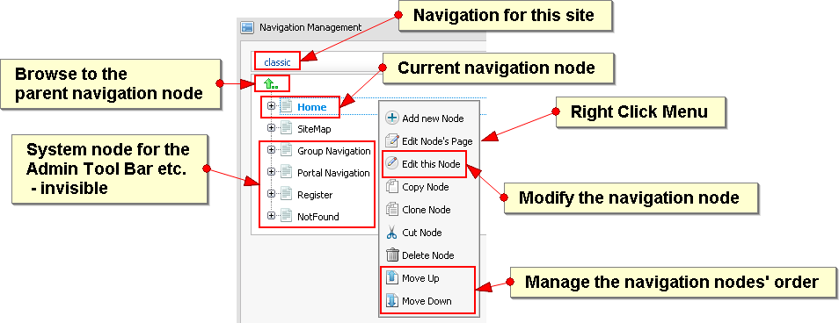
Navigation
Notes:
63

Slide 64
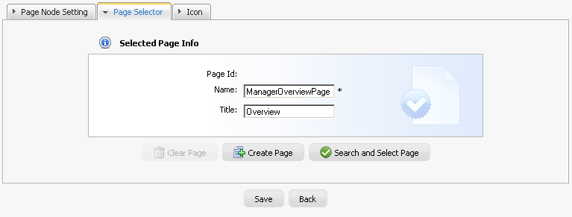
Navigation
Each navigation node is assigned to a page.
You create a new page or select an existing one.
You can point to same page from different navigation nodes.
Notes:
64

Slide 65
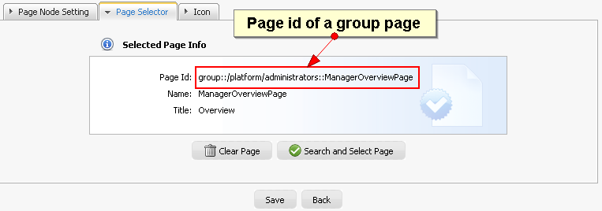
Navigation
Each page has a page name (internal) and a title (for interfaces).
The page is created automatically.
Notes:
65

Slide 66
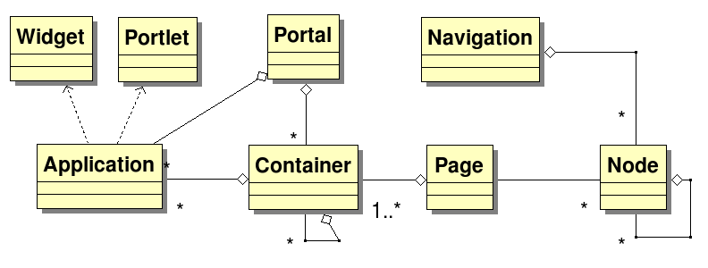
Portal Summary
Navigation is node based.
A page can be referenced by many nodes.
A portal is a set of pages and containers.
A page is a set of containers.
A container can contain applications and other containers.
Notes:
66

Slide 67
Exercise 4a: Site Navigation
New Site Page
Login as root.
Open a site page.
Click on “Add new page” and browse to the root of the navigation (green arrow).
Add at least one application to the page (otherwise it won’t show up). Save.
Site Navigation
Click on “Site” in the Admin Tool Bar and open the navigation of your site.
Verify the existence of your new navigation node and page.
Add a page to the administrator’s navigation.
Notes:
67

Slide 68
Exercise 4b: Site Navigation
Complex Navigation
Create the following user navigation :
• Shortcuts
• Search
• Yahoo
• Google
• eXo
• Blog
• Wiki
• Each page contains an IFrame portlet configured to go on the target site
• The “shortcuts”, “search” and “eXo” nodes reference the blog page
Notes:
68

Slide 69
Groups
69
Notes:
69

Slide 70

Groups
There can be a portal for each group. Portal = layout + pages + navigation
Each user belongs to one or several groups.
You see the navigations and pages of your groups in the Admin Tool Bar.
Only those users with the role “manager” can modify the navigation of a group.
Notes:
70

Slide 71

Groups
You see all groups you belong to, but only those which already have navigation.
If you are a manager, you can add new navigations for the other groups.
Notes:
71

Slide 72

Groups
By clicking on “Edit Properties” you can define the order of the group navigations in the menu.
Notes:
72

Slide 73


Group Navigation
Manage access to group pages
Notes:
73

Slide 74


Group Navigation
Notes:
74

Slide 75
Exercise 5: Group Portal
New Group Page
Login as root.
Open a group page of platform/users, the blog page for example.
Click on “Add new page” and browse to the root of the group navigation (green arrow).
Add at least one application to the page (otherwise it won’t show up). Save.
Groups Navigation
Click on “Group” in the Admin Tool Bar and open the navigation of platform/users.
Verify the existence of your new navigation node and page.
Add a navigation to the group platform/training, select any existing page.
Layout: Modify the layout of the platform/training portal.
Notes:
75

Slide 76
Application Registry
76
Notes:
76

Slide 77

Application Registry
An application can be a portlet or a gadget.
Notes:
77

Slide 78
Application Registry
In the registry you can configure which portlets are available to the user.
The available portlets appear in the page and portal layout dialogs.
You can define permission on category level and for each application.
The user only sees those portlets where permissions in both levels are granted.
Notes:
78

Slide 79

Application Registry
Portlets
Notes:
79

Slide 80

Application Registry
Gadgets
Can be loaded, created and modified.
Notes:
80

Slide 81
Navigation Internationalisation
81
Notes:
81

Slide 82

Navigation Internationalisation
Internationalisation
Uses keys in the label fields
Format: #{key}
Notes:
82

Slide 83
Navigation Internationalisation
Internationalisation
The corresponding keys are in properties files.
For example, the keys for Italian for the classic site are in: ...\webapps\portal\WEB-INF\classes\locale\navigation\portal\classic_it.properties
Example Content:
portal.classic.home=Home
portal.classic.sitemap=Mappa del Sito
portal.classic.groupnavigation=Navigazione dei Gruppi
portal.classic.portalnavigation=Navigazione del Portale
portal.classic.register=Registrazione
portal.classic.webexplorer=Web Explorer
UIAddNewApplication.label.AddApplication = Aggiungi Applicazione
Notes:
83

Slide 84
Examples
84
Notes:
84

Slide 85


Slide 86


Slide 87


Slide 88


Slide 89
eXo Fundamentals Training
Portal Elements and Organization Model
Q & A
Notes:
89

Slide 90
WebOS
Currently not available for GateIn
Desktop window environment for standard Portlets
Desktop in the Browser
Free moving for applications and widgets
Access your apps from the Dock
WebOS is just a special view of GateIn with the same functionality
Notes:
90

